Slide 1
Mobile PROs with FHIR
Hannah Burkhardt
PhD Student
University of Washington
Notes:
Hello everyone, I’m Hannah and I’ve been working with the
Clinical Informatics Research Group to develop a
FHIR-enabled mobile application for recording patient reported outcomes, or PROs, which I’m excited to be able to tell you about today

Slide 2
This is a work in progress
This is my first time developing a FHIR application
Some of the technologies we are using/considering are new to CIRG
I’d love to hear your thoughts, ideas, and feedback!
Notes:
Before I get started I’d like to you know that this is work in progress, in fact some things I will talk about aren’t much more than ideas right now. This is my first time using FHIR, and we are exploring and experimenting with a number of technologies that are new to myself as well the clinical informatics research group and trying to figure out how to make them work for us
So I’d love to hear your thoughts on our approach, and I am especially curious how you have addressed similar problems if you’ve had them, or what your ideas are for how to approach them

Slide 3


Patient Reported Outcomes (PROs)
PROs are
An opportunity to administer screening tools
E.g. depression and anxiety questionnaires
A window into the patient experience for the purpose of tracking treatment progress and effectiveness
E.g. pain tracking
An opportunity for the patient to take an active part in their care
Notes:
Patient Reported Outcomes or PROs are often collected using surveys but patient generated data can come from a number of sources.
Examples are pain tracking and depression questionnaires and other screening tools, and activity data generated by wearable devices.
As such PROs are a not only a window into the patient’s experience of their own health and health care for health care providers, but also present an opportunity for patients to express themselves and so take an active part in their care.

Slide 4

Mobile Health Apps
Consumer health applications can help users manage their health issues:
Smartphones are becoming ubiquitous companions and are thus well suited to
Deliver reminders
Facilitate regular check-ins
Engage users through gamification
mHealth apps also present unique opportunities through integration with sensors and other hardware
Notes:
Many PRO systems today are web apps but here we are proposing a mobile application.
Because smartphones are increasingly ubiquitous companions, The mobile platform comes with a host of opportunities to better support the users’ goals in managing health issues such as ….
An important opportunity is the automated collection of data through sensors, both those built into the device such as location tracking as well as

Slide 5
Objective
Develop a mobile app for collecting PROs that is
adaptable
Notes:
So we set out to develop a mobile application that is adaptable to a number of different health apps or health issues with similar self-management challenges. CIRG currently has a number of different PRO applications for health issues ranging from cancer, chronic pain, HIV, and surgical wound care. And there are many other potential use cases for the type of application that we are working on, some of which I will discuss in a second.

Slide 6
Objective
Develop a mobile app for collecting PROs that is
adaptable
cross-platform
Notes:
Of course mobile applications should ideally be universally deployable regardless of operating system, so we wanted to use a cross-platform application development framework.

Slide 7
Objective
Develop a mobile app for collecting PROs that is
adaptable
cross-platform
offline-first
Notes:
Finally the offline-first mentality that is becoming increasingly popular in app development is important for the so called next billion users, which include people without continuous internet connection such as those in rural areas and even developing countries. So for this project we wanted to design for disconnected operation from the start.

Slide 8
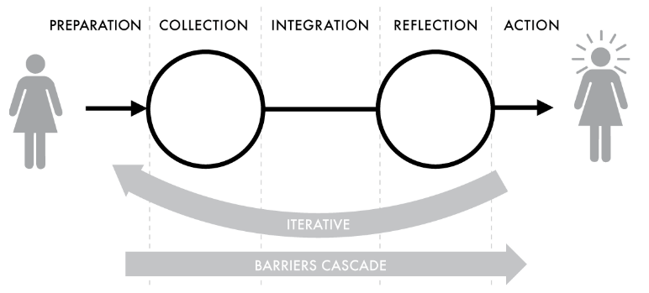
PRO App Requirements
Facilitate planning
Collect data:
Subjective – questionnaires
Objective – sensors
Visualize trends
﻿Stage-based model of personal informatics (Li et al., 2010)
Li, I., Dey, A., & Forlizzi, J. (2010). A stage-based model of personal informatics systems. Conference on Human Factors in Computing Systems - Proceedings, 1, 557–566. https://doi.org/10.1145/1753326.1753409
Notes:
We envision an application that allows the user to
plan treatment activities,
record data about those activities, either through questionnaires or automatic capture from sensors,
record their symptoms
visualize trends in their symptoms and treatment adherence
These 3 activities together form a kind of diary application that individuals can use to manage their health issues and take an active part in their health care. Users can longitudinally collect data about their activities and symptoms, integrate and reflect on that data, and take action based on their findings.
The stage-based model of personal informatics describes barriers to these different stages that can be addressed by an application such as ours, for example
barriers to collection include remembering to enter the data, which could be addressed through reminder notifications, and difficulty entering data accurately, e.g. for how long a certain exercise was done, which could be addressed by directly integrating with sensors and external devices.
Integration barriers include organizing the data for example if different data sources have to be integrated, which our app could handle by displaying planned activities along with actually undertaken activities and collected data
Reflection barriers include visualizing data which can again be difficult if there are multiple sources of data. Displaying different data together in one holistic view can be especially useful, for example to see how treatment adherence affects symptoms over time.

Slide 9
Health issues
 | Questionnaire | Treatment activity | Sensor opportunity
Urinary incontinence | Incontinence questionnaire | Pelvic floor muscle training sessions
Physical therapy | Mobility questionnaire | -Exercises -Walking | Activity tracker
Mental health | Depression, anxiety, stress questionnaires | -Mindfulness -Thought exercises | -Sleep quality trackers -Mindfulness app usage
Notes:
The types of health issues that we might address, include some element of care planning and continuous assessment:
Urinary incontinence and other women’s health issues experiences primarily by postnatal and postmenopausal women
* assessment of urinary incontinence
standardized instrument: Functional Assessment of Incontinence Therapy
Physical therapy after breaking a leg or foot
Questionnaire that asks about range of motion, weakness, etc.
20 min walk every day
Sensor: activity tracker that integrates with the app
Mental health
Depression or anxiety questionnaires, stress
Mindfulness or thought exercises

Slide 10
FHIR can make our app re-usable for different health problems
CarePlan
Questionnaire
Procedure

Slide 11
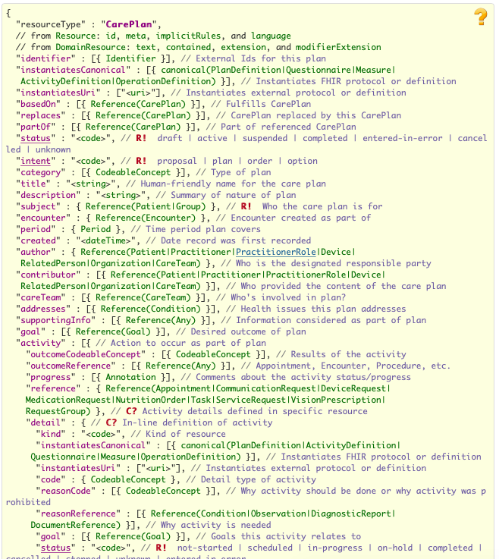
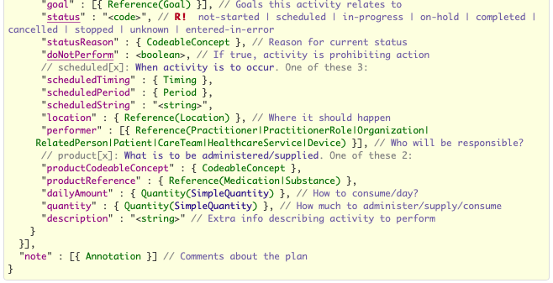
CarePlan

Slide 12
CarePlan

Slide 13
CarePlan

Slide 14
CarePlan
Questionnaire

Slide 15
CarePlan
Treatment activity

Slide 16
Patient
subject
CarePlan
Activity
Activity
Activity

Slide 17
Patient
subject
subject
CarePlan
CarePlan
Activity
Activity
Activity
Activity
Activity
Activity

Slide 18
Patient
subject
subject
CarePlan
CarePlan
Questionnaire
instantiatesCanonical
Activity
Activity
Activity
Activity
Activity
Activity
Treatment activity (Codeable Concept)
code

Slide 19
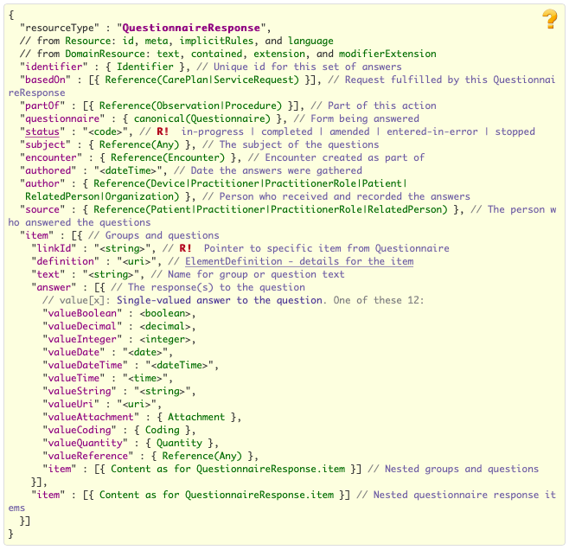
Questionnaire Response

Slide 20
Patient
subject
subject
CarePlan
CarePlan
Questionnaire
instantiatesCanonical
Activity
Activity
Activity
Activity
Activity
Activity
Treatment activity (Codeable Concept)
code

Slide 21
Patient
subject
QuestionnaireResponse
Item
Item
basedOn
Item
Item
subject
subject
questionnaire
CarePlan
CarePlan
Questionnaire
instantiatesCanonical
Activity
Activity
Activity
Activity
Activity
Activity
Treatment activity (Codeable Concept)
code

Slide 22
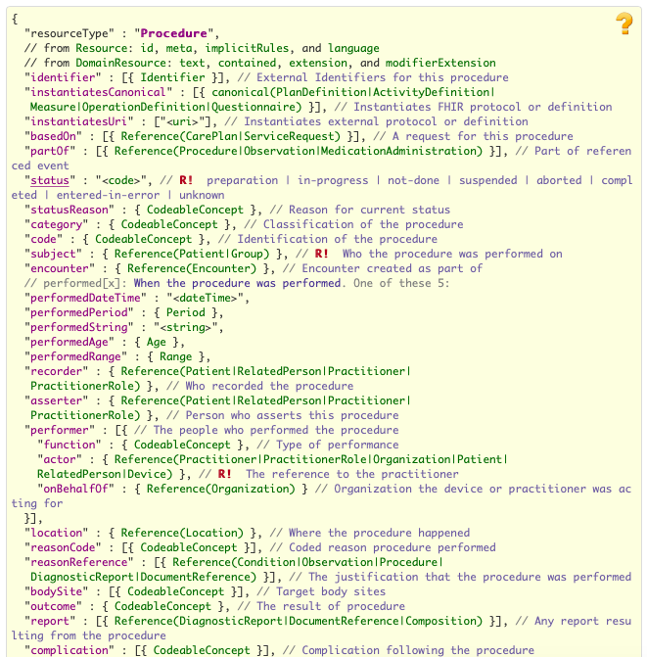
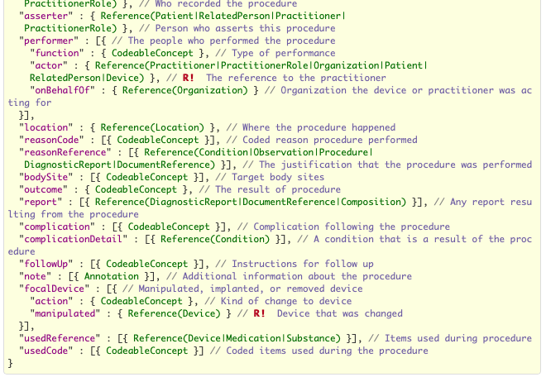
Procedure

Slide 23
Procedure

Slide 24
Patient
subject
QuestionnaireResponse
Item
Item
basedOn
Item
Item
subject
subject
questionnaire
CarePlan
CarePlan
Questionnaire
instantiatesCanonical
Activity
Activity
Activity
Activity
Activity
Activity
Treatment activity (Codeable Concept)
code

Slide 25
Patient
subject
QuestionnaireResponse
Item
Item
basedOn
Item
Item
subject
subject
questionnaire
CarePlan
CarePlan
Questionnaire
instantiatesCanonical
Activity
Activity
Activity
Activity
subject
Activity
Activity
Treatment activity (Codeable Concept)
code
code
Procedure
basedOn

Slide 26
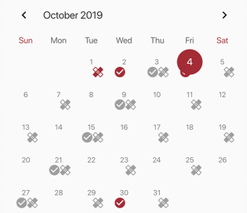
Calendar
Notes:
These resources are consumed by the mobile client application, for example to populate this calendar.

Slide 27
Patient
subject
QuestionnaireResponse
Item
Item
basedOn
Item
Item
subject
subject
questionnaire
CarePlan
CarePlan
Questionnaire
instantiatesCanonical
Activity
Activity
Activity
Activity
subject
Activity
Activity
Treatment activity (Codeable Concept)
code
code
Procedure
basedOn
Notes:
From our app’s point of view, we query the database by starting with the patient resource, which is linked to the user login which lives in a separate identity provider database.

Slide 28
Patient
subject
QuestionnaireResponse
Item
Item
basedOn
Item
Item
subject
subject
questionnaire
CarePlan
CarePlan
Questionnaire
instantiatesCanonical
Activity
Activity
Activity
Activity
subject
Activity
Activity
Treatment activity (Codeable Concept)
code
code
Procedure
basedOn
Notes:
We then find the currently active careplan for that patient

Slide 29
Patient
subject
QuestionnaireResponse
Item
Item
basedOn
Item
Item
subject
subject
questionnaire
CarePlan
CarePlan
Questionnaire
instantiatesCanonical
Activity
Activity
Activity
Activity
subject
Activity
Activity
Treatment activity (Codeable Concept)
code
code
Procedure
basedOn
Notes:
Then using the careplan’s ID, we find all questionnaireResponse and Procedure resources linked to that CarePlan.

Slide 30
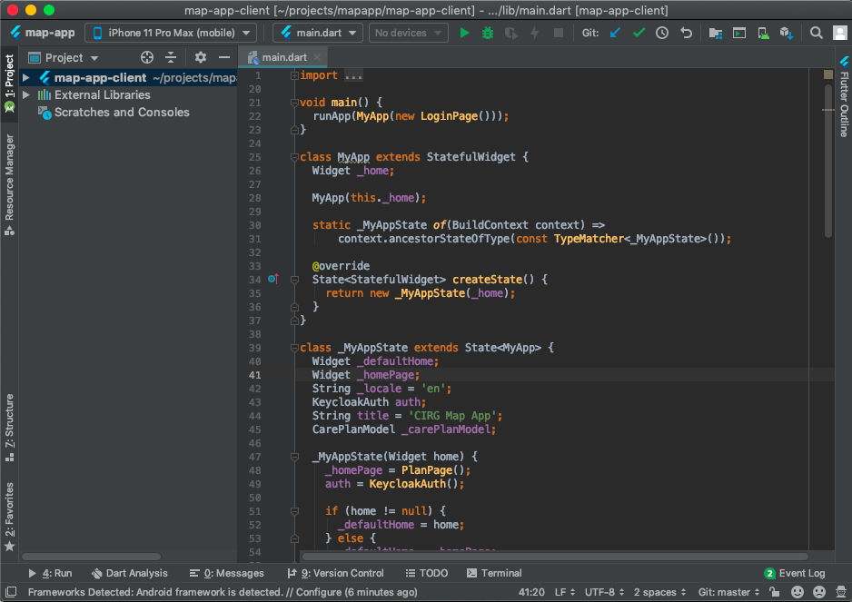
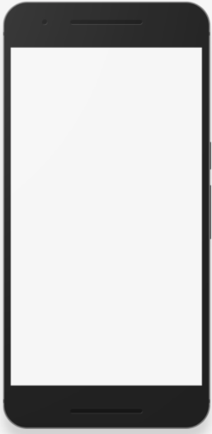
Cross-platform framework: Google’s
Deploy to iOS, Android, and Web
Extensive catalog of community-contributed libraries
User interface is rebuilt automatically when there is a change in the data model

Slide 31




Offline-first mobile app with , and ?
events
sync
replication

Slide 32
Challenges
FHIR resources
Procedure?
Offline operation
CouchBase vs. CouchDB?
FHIR resource validation?
Offline login?

Slide 33
Thank you!

